Slide 1
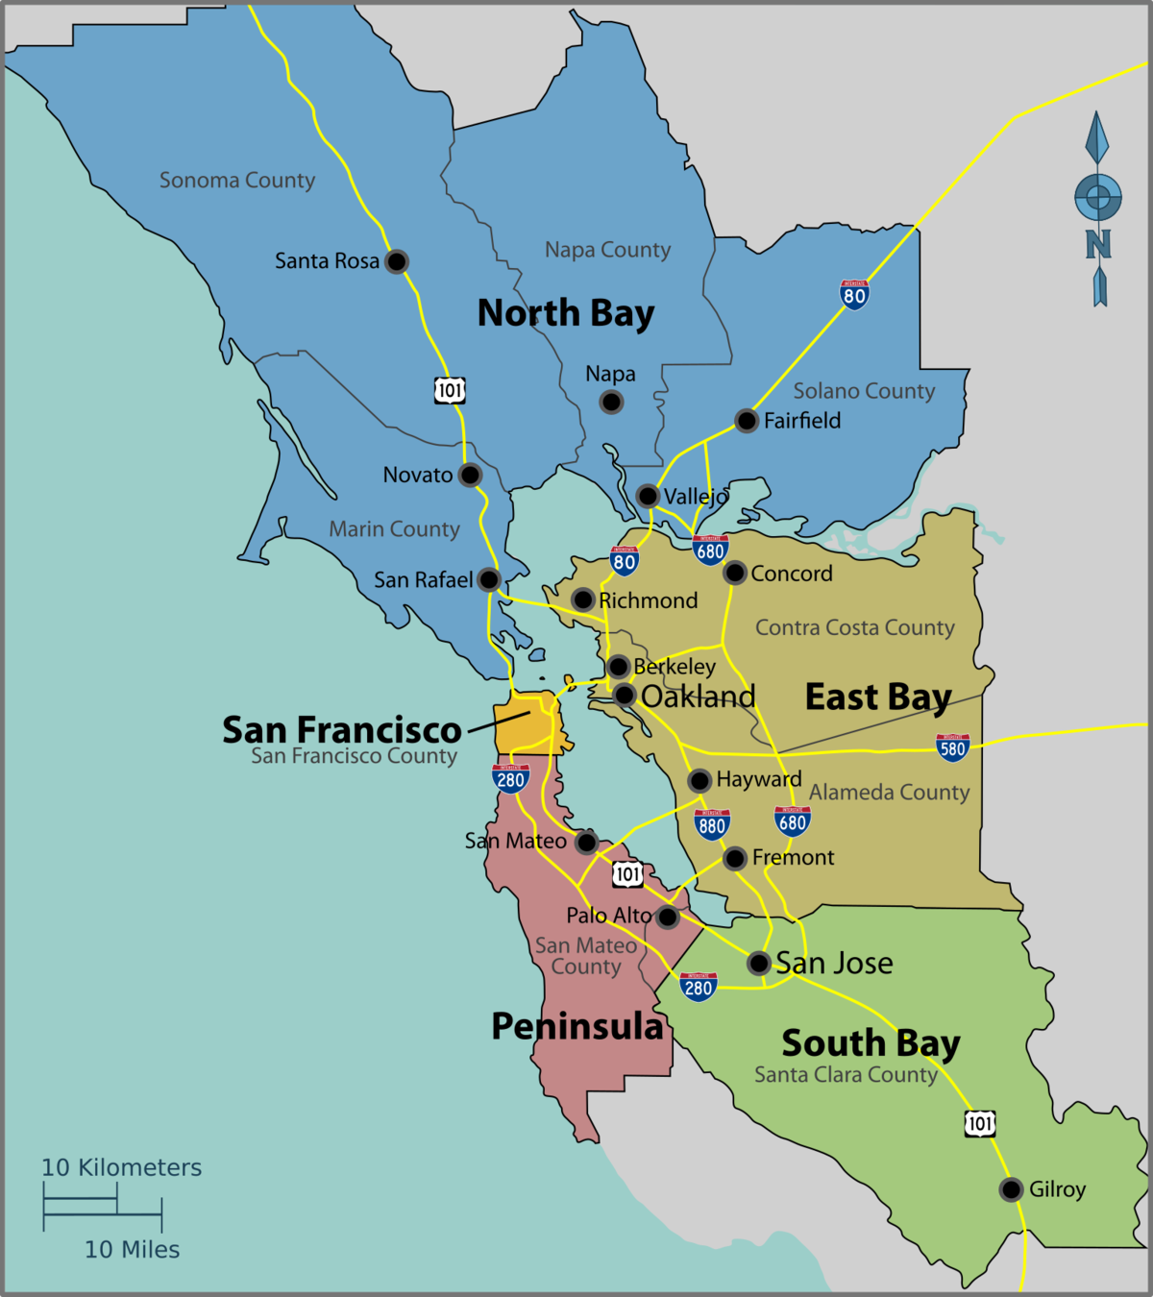
Residential Water Use In The Bay Area
2012-2019
Terrence Kurylo

Slide 2
Primary Questions
1. What were cities water usage levels relative to each other?
2. Was there significant difference in drought conditions between cities?
3. What role did elevation play in water use and drought conditions?
4. What were the differences in water use by residence type? (single household, multifamily & apartment complexes)
5. Did drought conditions change water use, if so, how?

Slide 3
Primary Methodology
Primary data was complied from 54 .xlsx files, comprising 15+ million rows.
Data was cleaned, top decile outliers were dropped, and numeric customer codes were converted to customer types according to the East Bay Municipal Service.
Data was enriched from a secondary data source containing drought records from the US Drought Monitor.
A Drought Factor ranging from 1 to 175 was constructed by weighting drought conditions from category 0 to 4 and applied to the time periods of the primary data.
From the primary data, a Gallons Used Daily measure was created by converting from the total CCF of water used over the period to gallons, then dividing it by the billed days in that period.
A link to the code can be found here.

Slide 4
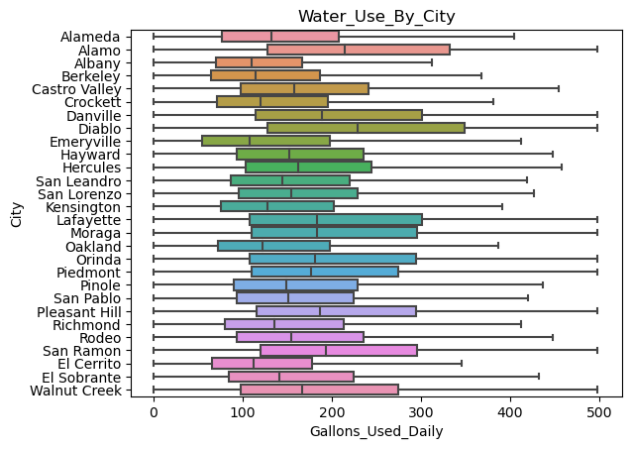
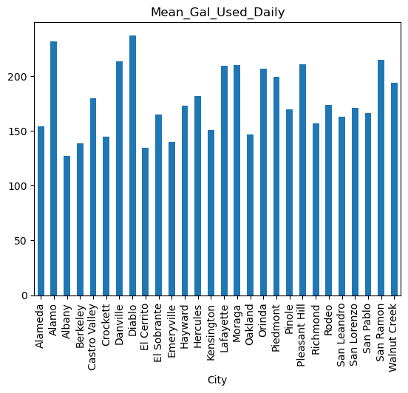
What were cities water usage levels relative to each other?
While there was significant variance, water use generally clustered between 100 & 300 Gallons per day.
Mean water use for the region: 177 gallons per day
Diablo used the most water, while Crockett used the least.

Slide 5
Top and Bottom 5 Cities by Mean Water Use (mean values)
Highest Users | Gallons Per Day | Drought Factor | Elevation Band
Diablo | 237 | 49.10 | 2.1
Alamo | 231 | 49.17 | 1.9
San Ramon | 214 | 49.73 | 2.0
Danville | 213 | 49.64 | 2.2
Pleasant Hill | 210 | 49.89 | 1.0
Lowest Users | Gallons Per Day | Drought Factor | Elevation Band
Albany | 127 | 49.42 | 1.0
El Cerrito | 134 | 49.93 | 1.4
Berkley | 138 | 49.43 | 1.5
Emeryville | 139 | 50.03 | 2.2
Crockett | 144 | 43.07 | 1.4
What could explain this variance?

Slide 6
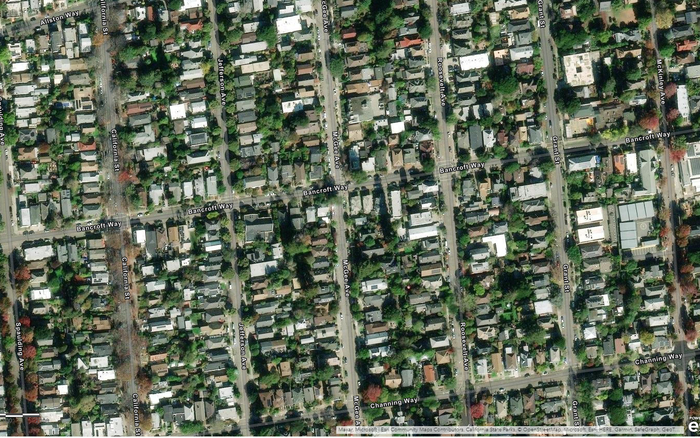
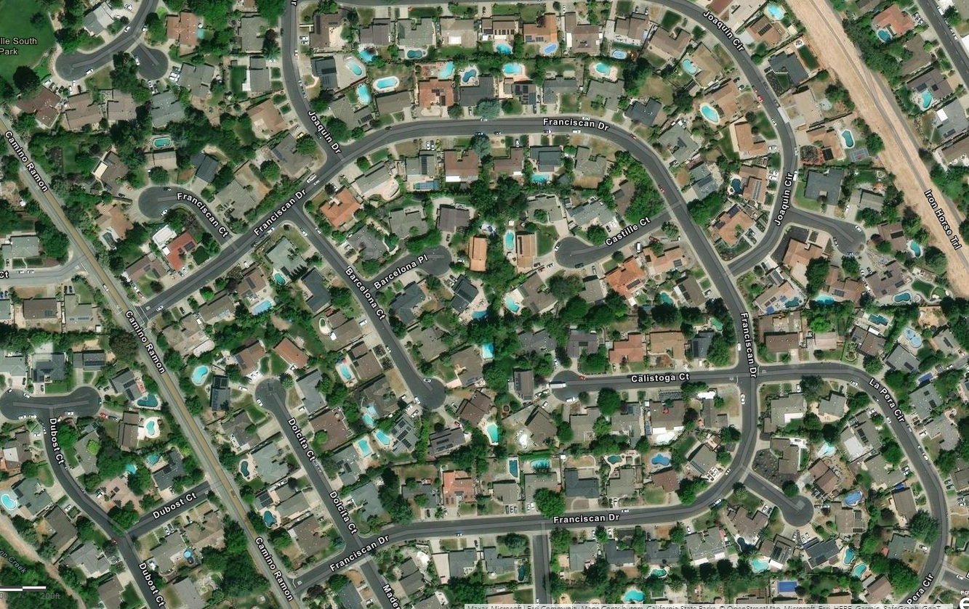
Comparing residential areas using ArcGIS
Berkley (bottom 3 of 5)
San Ramon (top 3 of 5)
High water use cities show a general trend of larger homes, yards and an abundance of pools.
Each of the top 5 water use cities has a golf course, only one of the bottom 5 (El Cerrito) does.
Low water cities use have higher density with mixed commercial and residential zoning.

Slide 7
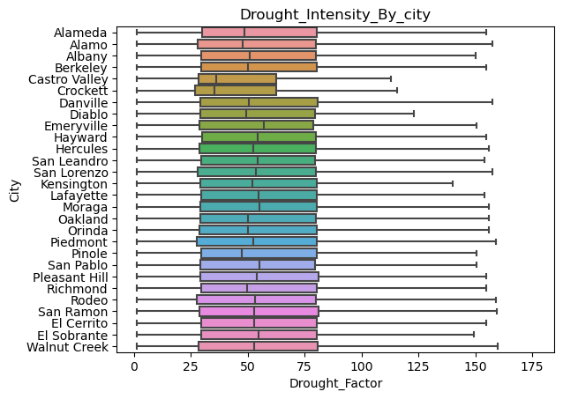
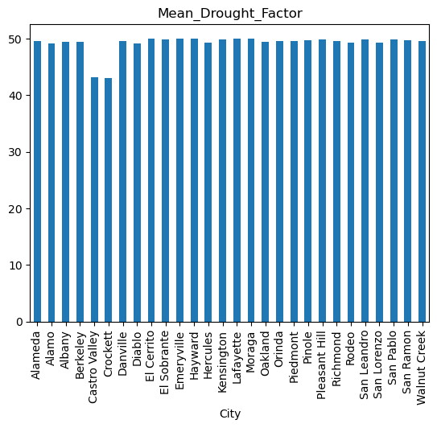
Was there significant difference in drought conditions between cities?
Drought Intensity was broadly consistent between cities, with a drought factor ranging from 25 to 80 for the Interquartile Range.
Mean Drought Factor for all cities was 49.9, out of a maximum of 175.
Castro Valley and Crockett had notably lower Drought Intensity.

Slide 8
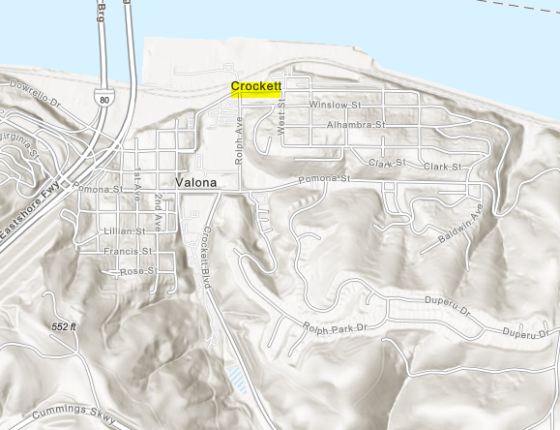
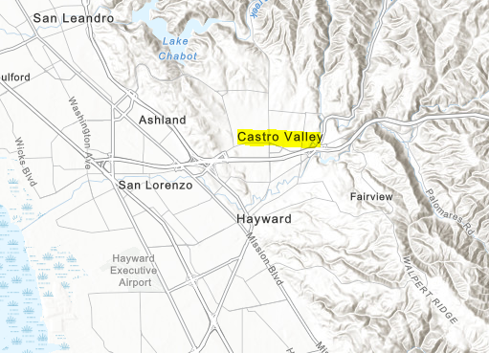
Comparing low drought factor cities using ArcGIS
Crockett
Castro Valley
Both low drought factor cities are near the bay and surrounded on three sides by mountains.
As moist air travels up mountains it cools and produces increased precipitation and humidity.
Pinole, which also has a relatively low drought condition has similar topography.

Slide 9
Side by side comparison of cities water use and drought factor
Water use varied heavily between cities while drought conditions generally did not.

Slide 10
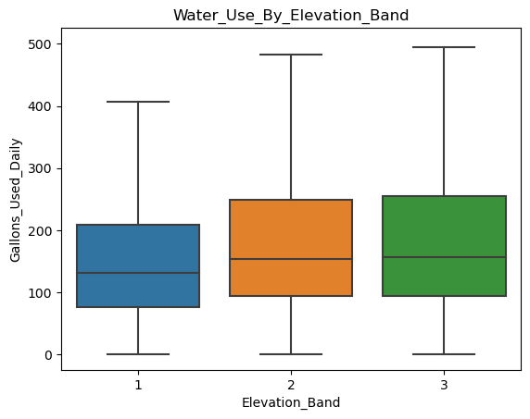
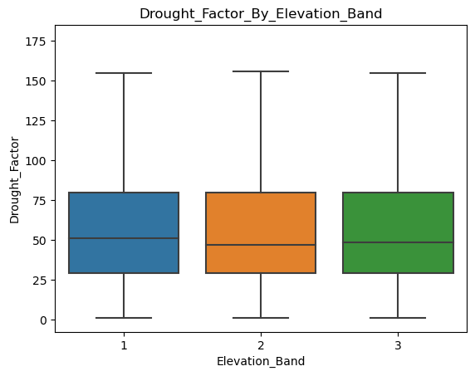
What role did elevation play in water use and drought conditions?
Elevation caused a slight difference in water use.
Elevation caused no variation in drought factor.
Mostly between the lowest elevation band 1 and band 2.
Though surrounding high elevations appear to in some cases.
While elevation played a very slight (statistically insignificant) role in water use, this was independent of the drought.

Slide 11
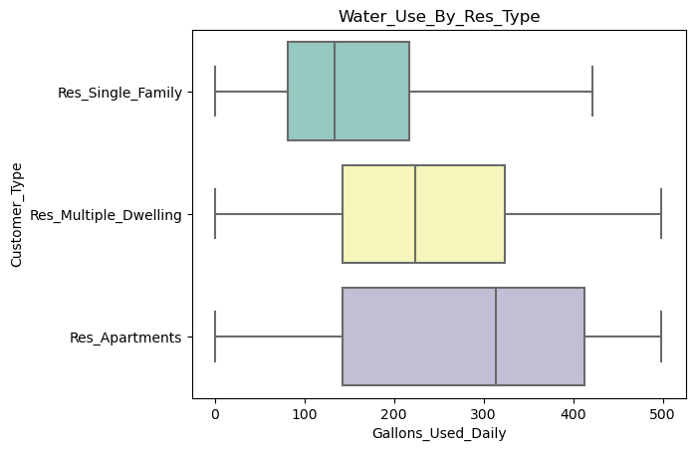
What were the differences in water use by residence type?
Residential Type | Mean (adjusted) | Mean (w/ outliers)
Single Family | 159 | 214
Multiple Dwelling | 235 | 234
Apartments | 274 | 2463
There was notable variation in water use between residency type, likely as a result of increased individuals per billable address.
Variation increases significantly when outliers of the top decile are included. High use accounts far exceed the average use.

Slide 12
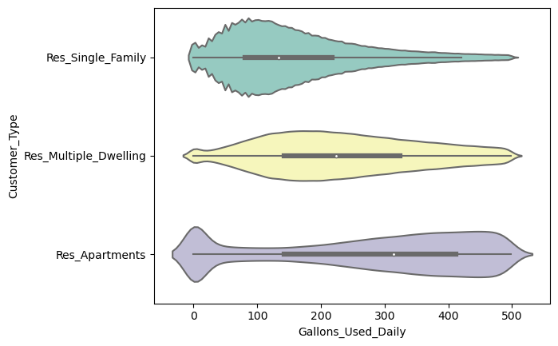
What were the differences in water use by residence type? (continued)
We have significant difference in distributions, with progressively higher median water use values between residency types.
Single Family: use values are clustered around the lower end, showing lower average water use.
Multiple Family: The overall distribution is more even, showing a broad range of water use.
Apartments: use values cluster around the top of the range, showing high water use relative to other residence types. Account for 2% of accounts, but 32% of water use.
We also have a notable tail on all residence types, likely representing vacancies.

Slide 13
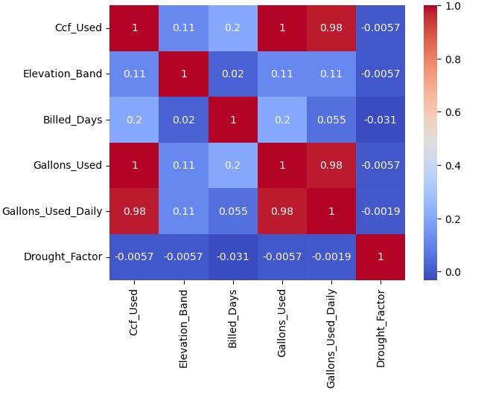
Did drought conditions change water use, if so, how?
No, water use did not change in response to drought conditions, having a near 0 correlation
This supports observations from previous data regarding cities water use (high variance) relative to drought conditions (low variance).
Water use mitigation efforts likely only effected statistically insignificant high water use outliers and had little effect on the general population’s water use.
The following slides will discuss how this conclusion was reached despite data which potentially suggested otherwise.

Slide 14
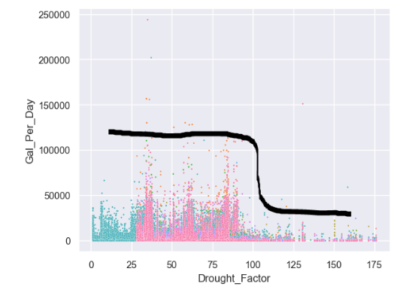
Divergent Data: a misleading scatterplot.
Before top decile outliers were removed, scatterplots showed a clear drop off in water use at a drought factor of approximately 90.
This suggested we should see correlation, as water use appeared to drop due to a drought condition of 90+.
However, this contradicted the heat map in the previous slide, which showed near 0 correlation.
This required further investigation, to determine the irregularity, and which graph (heatmap or scatterplot) reflected actual water use trend relative to drought factor.

Slide 15
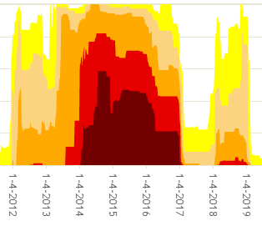
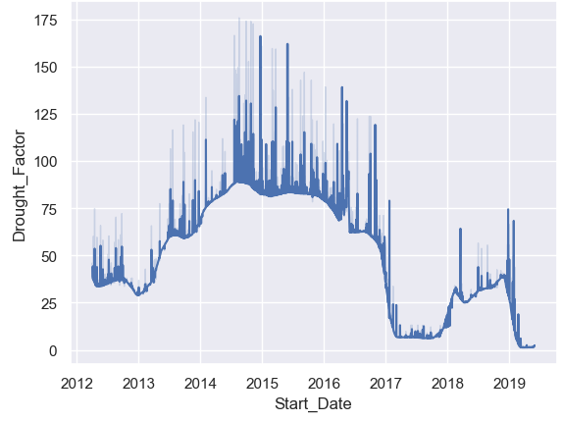
Checking the Drought Factor
Drought factor calculations were checked for accuracy and rationale in weighting.
Source data, before computation of drought factor was graphed.
Source data graph (top) and drought factor graph (bottom) were compared.
Drought factor (a population weighted scale ranging from o to 175) was found to fit the source data.
A link to the code can be found here.

Slide 16
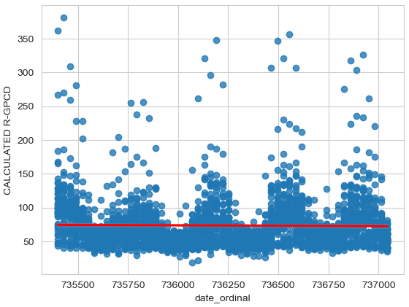
Validating water use independence from drought conditions
Independent data on water use in the SF Bay area was gathered from a separate source.
Data ranged over a shorter span, from 2014 to 2019.
Data covered both cities within our dataset, and without, but all within the same area.
Dates were converted to ordinal values for graphing, they cover the 2014-2019 period in which drought factor has high variation.
Graphing and calculations determine that water use trends are flat, with little to no variation regardless of corresponding drought conditions over the period.
Code can be found here.

Slide 17
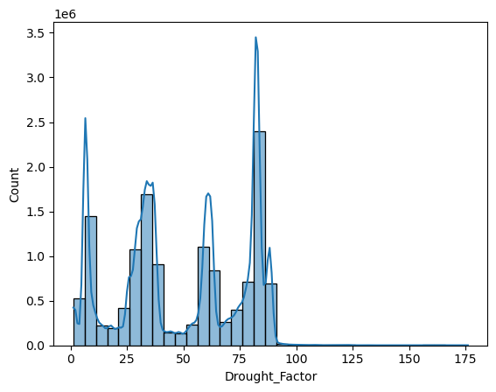
Explaining the drop off
In order to explain the drop off seen on the scatterplot, signifying responsiveness in water use to a drought factor of 90, a histogram of the data points by drought factor was plotted.
The histogram (top, in millions) shows the distribution of our primary data points.
The same drop off can be observed at a drought factor of approximately 90.
A drought factor value greater than approximately 90 is an outlier. There are simply very few points at which the drought factor goes above 90, thus we see a drop off in data points on the scatterplot at 90.
The drop off is a result of our data shape, a lack of periods above 90 drought factor, not responsiveness of water use to drought factor.

Slide 18
Conclusions
What were cities water usage levels relative to each other?
Water usage had high variation, largely as a result of pools, larger yards and density.
Was there significant difference in drought conditions between cities?
No, drought conditions were regionally contiguous aside from two exceptions.
What role did elevation play in water use and drought conditions?
Elevation played only a statically insignificant role in water use and none in drought conditions.
What were the differences in water use by residence type?
Residence type played a predictable role in water use, more residents increased water use.
Did drought conditions change water use, if so, how?
No, water use was consistently independent of drought conditions.

